Slide 1

AI-Powered Regulated RTO Agent Platform
Transforming vehicle documentation services through intelligent automation and verified agent networks.
Notes:
1

Slide 2
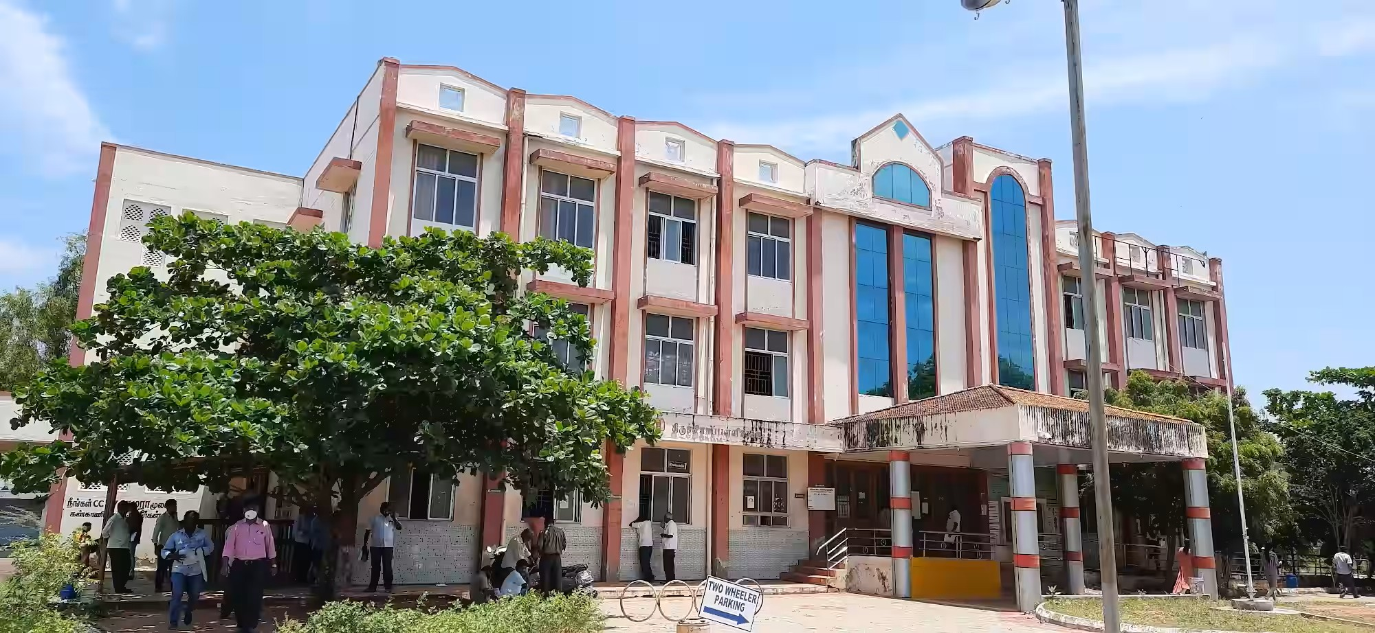
Table of Contents
Introduction
Literature Survey
Objectives
Core Components
Methodology Flowchart
Impacts on Stakeholders
Agent Network Management
Workflow Architecture
Key Takeaways

Slide 3

Introduction
Although the Government of India’s Parivahan portal provides online access to transport-related services, many citizens particularly the uneducated, digitally inexperienced, and first-time applicants struggle to use it effectively
As a result, they depend heavily on private brokers, who often exploit this dependency through practices such as overcharging, ghosting, and misrepresentation of processes. Eliminating brokers entirely is not feasible, as government officials cannot singlehandedly manage the workload.
This project proposes an AI-powered regulated RTO agent platform that integrates brokers into a transparent, accountable, and citizen-friendly ecosystem. Only registered brokers are permitted, and every transaction is initiated and closed using citizen OTPs,
The outcome is an intelligent, citizen-centric system that eradicates dependency on unregulated middlemen, minimizes corruption, and increases accessibility to RTO services for all categories of users, including those with low literacy levels
Notes:
2

Slide 4
PAPER DETAILS | SYNOPSIS | ALGORITHM USED | LIMITATIONS & IDEAS
Alsafari et al. (2024) Towards effective teaching assistants: From intent-based to RAG chatbot | LLM-powered teaching assistant using a Retrieval-Augmented Generation (RAG) approach | The RAG(Central Algo for chatbot), Intent-based chatbot: Amazon Alexa Skill, AWS Lambda functions, and a knowledge base stored in a JSON file | RAG system’s potential for the conversation context to exceed the LLM's token limit during long dialogues
Yigci et al. (2025) Assessing the effectiveness of large language models for intent detection in tourism chatbots | Focussed on assessing the effectiveness of several prominent LLMs (GPT-2, BERT, RoBERTa, and LLAMA 3.1) | LLM architectures like BERT, GPT-2, RoBERTa, and LLAMA 3.1 involves fine-tuning these pre-trained models on a specific tourism dataset | Findings might not be generalizable to other fields the significant computational resource requirements for fine-tuning these large models, making difficult to one with limited infrastructure.
Pukale et al. (2024) Image Forgery Detection Using Deep Learning | Combine Error Level Analysis (ELA) preprocessing with deep CNN (VGG16) to classify and localize image forgeries Report high accuracy (VGG16 ~97% on CASIA datasets). | ELA preprocessing, VGG16 (transfer learning), CASIA1/2 datasets, typical deep-learning training stack. | Strong dependence on ELA (which can be bypassed) tested mainly on CASIA datasets potential overfitting and limited robustness to re-compression/camera processing.
Han Li et al. (2022) Dynamic Rating Technology (Particle Swarm Optimization) | Combines ranking mechanisms with dynamic learning strategies to balance exploration and exploitation in optimization problems. | Evolutionary computation, PSO with ranking and switching strategies. | Computational overhead, parameter sensitivity, not directly broker-specific but adaptable.
Valavan & Rita (2022) Predictive-Analysis ML Model for Fraud Detection | Empirical comparison for loan/credit fraud detection. Gradient-boosted trees generally outperform single tree models on their datasets | Classical ML libraries (scikit-learn style methods), boosting (Gradient Boosting), evaluation via confusion matrix, ROC. | Uses relatively small / domain-specific datasets; mostly classical tabular methods; limited exploration of deep-learning or unsupervised detection.

Slide 5
Objectives
1
2
Enhanced Transparency
Reduced Corruption
The platform provides a clear, auditable trail for all transactions, significantly reducing opportunities for frauds and increasing public trust in government processes.
Automated checks and AI-driven monitoring minimize human intervention in sensitive areas, effectively mitigating risks associated with corruption and ensuring fair service delivery.
3
4
Dynamic Rating System
Improved Citizen Experience
Classify brokers as Gold, Silver, Bronze, or Blacklisted based on punctuality, complaints, and completion rates.
Citizens benefit from faster, more reliable, and transparent services, leading to greater satisfaction and confidence in public administration.
Notes:
3

Slide 6




Core Components: The Engine of Efficiency
LLM-Powered Chatbots
ML-Based Fraud Detection
Intelligent chatbots provide instant support and guidance to citizens and agents, resolving queries efficiently and enhancing user experience.
Machine learning algorithms continuously analyze transaction data to identify and flag suspicious activities, safeguarding against fraudulent practices.
OCR for Document Processing
Dynamic Ratings
Optical Character Recognition automates the extraction of information from documents, drastically reducing data entry errors and processing times.
The system will regulate brokers through a portal where only registered agents are allowed. Brokers must initiate and close jobs with citizen OTPs, ensuring accountability and performance tracking
Notes:
4

Slide 7
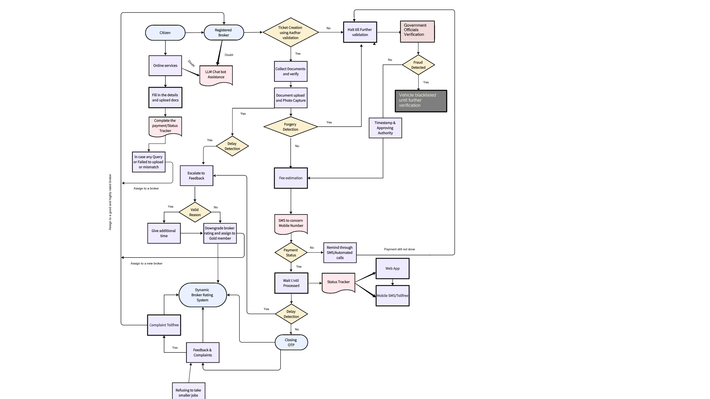
Workflow Methodology

Slide 8
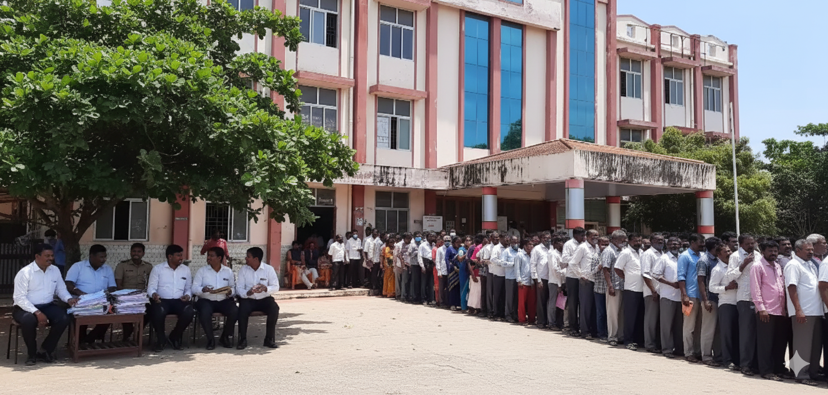
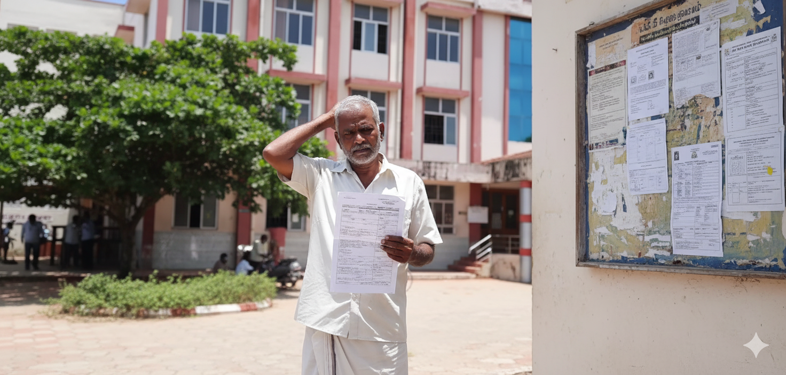

Impact on Stakeholders
For Citizens
For Government Agencies
Faster turnaround times for vehicle documentation.
Reduced bureaucratic hurdles and paperwork.
Increased trust due to transparent processes
Accessible and responsive support through AI chatbots
Significant reduction in administrative overhead.
Enhanced data accuracy and security.
Improved regulatory compliance and fraud prevention.
Better resource allocation by automating routine tasks.
Notes:
5

Slide 9
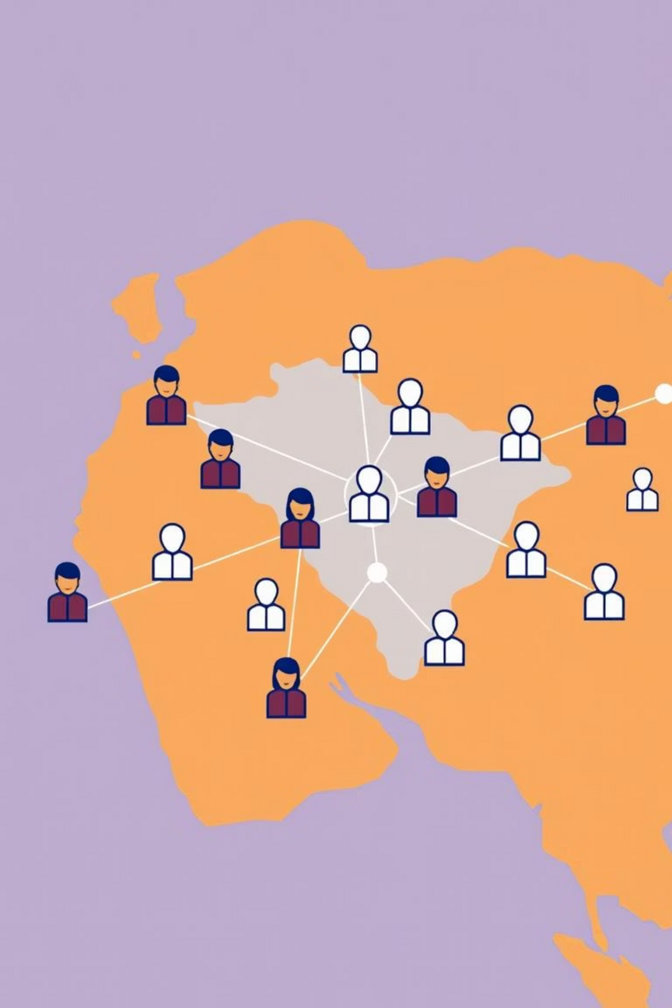
Agent Network Management
A crucial aspect of the platform is the robust system for managing and monitoring RTO agents. This ensures service quality and upholds the integrity of government processes.
Broker Tracking System
1
Real-time tracking of agent activities and transaction statuses ensures accountability and operational oversight.
Dynamic Broker Rating
Agents are rated based on performance metrics and customer feedback, promoting high-quality service and continuous improvement.
2
Notes:
6

Slide 10
Ensuring Service Excellence
Customer Feedback Loops
Continuous Monitoring
Performance Incentives
Automated systems monitor agent compliance and service quality, ensuring adherence to regulatory standards.. Also based on the customer feedback and work completion timeline brokers grade will be modified
Top-performing agents are recognized and rewarded, fostering a competitive yet collaborative environment focused on service excellence.It also allows them to get more jobs compared to other brokers
An integrated feedback system allows citizens to rate their experience, providing valuable insights for service enhancement and agent performance evaluation.
Notes:
7

Slide 11

Workflow Architecture
Citizen requests service via mobile/web/IVR/WhatsApp.
Broker receives OTP from citizen to initiate the job (timestamp recorded).
Broker uploads documents → OCR + forgery detection validates authenticity.
4. Fraud detection engine monitors fees, delays, and anomalies.
Progress updates are automatically sent to citizens via SMS
Task completion requires citizen OTP to close the job.
Dynamic rating system adjusts broker rank (Gold/Silver/Bronze/Blacklist).
Escrow payment is released only upon completion.
Government APIs (Parivahan/Vahan/DigiLocker) are integrated for validation and cross-checks.
.
Notes:
8

Slide 12
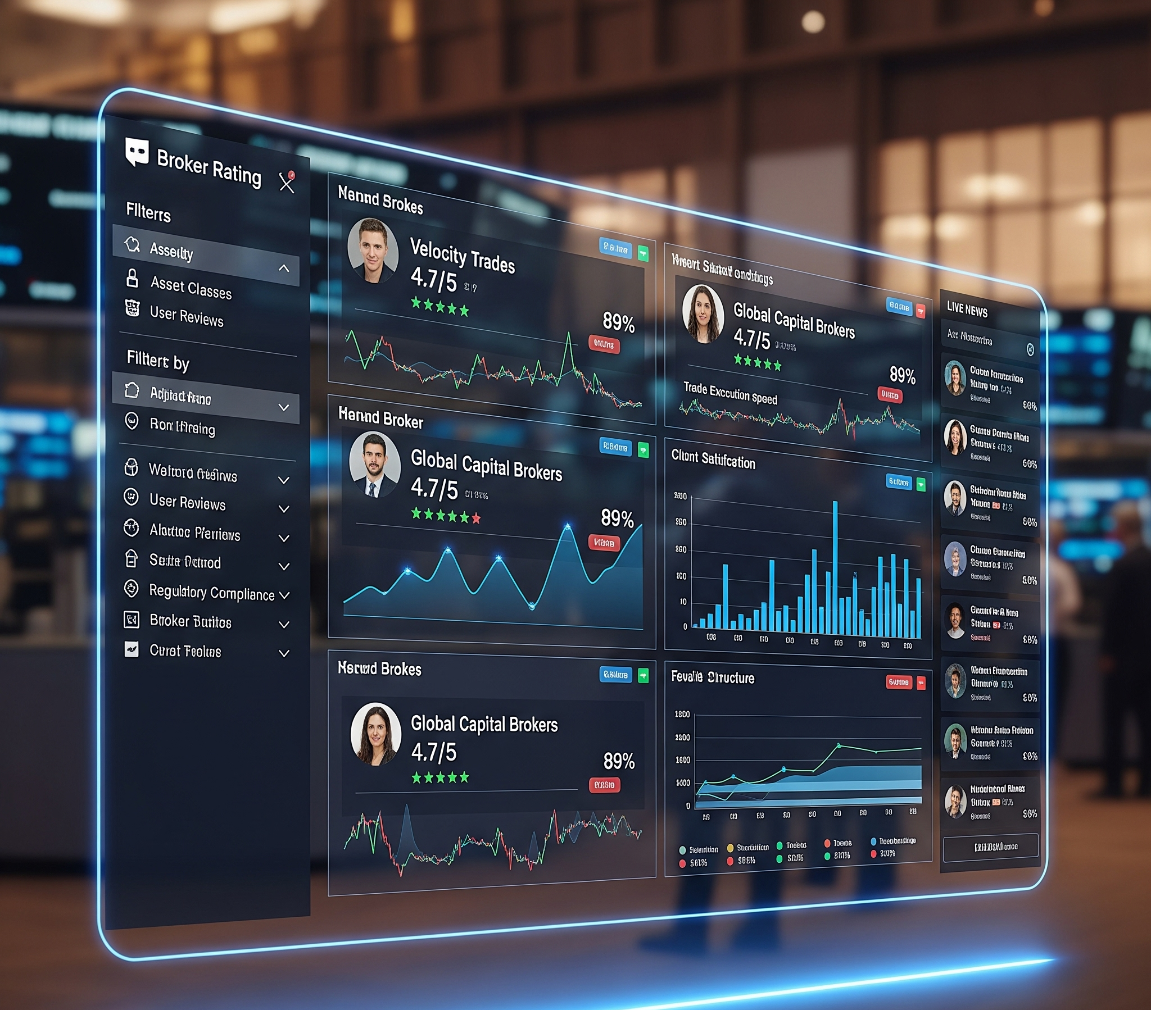
Key Takeaways
AI-Driven Efficiency
Leveraging AI, ML, and OCR to check and optimize RTO processes.
Citizen-Centric Design
Improving access, speed, and satisfaction for all users of vehicle documentation services.
Enhanced Trust
Combatting corruption and increasing transparency through robust monitoring and feedback.
Scalable Solution
A platform designed for growth and adaptability, ready to meet evolving public service needs.
Notes:
9

